Slide 1
Signature Verification
DSIP MINI-Project

Slide 2
Introduction
Even in todays age signature is the most important and most used form of proof of identity of a person. Signatures are used for all documents in financial services, legal services or on letters, documents, checks, security documents.
Thus to reducing illegal acts like forgery are a great concern in our day and age.
Negligence of signature verification is one of the main cause of fraud in our country. So to avoid such cases, we decided to make this project.

Slide 3
Problem Statement
To write a program in MATLAB that can distinguish between genuine and forged signatures.

Slide 4
Methodology
Database Preparation
Pre-Processing
Feature Extraction
Verification using extracted Features
Working

Slide 5
Database Preparation
For the code we have written, we require a square image with high resolution and which is noise free.
Signature should be made on an uncrumbled blank sheet of paper and shot with a camera which is focused on the image.
The image should then be modified to a square resolution to be used.
So we took a database from internet with Genuine and Forged Images.

Slide 6
Pre-Processing
The Steps of Pre-Processing of the image from database is :
1. Cropping
2. Filtering
3. Conversion of Colour Image to Gray scale
4. Binarization of Grey scale image
5.Thinning
6. Rotation for Skew Correction
7. Resizing

Slide 7
Feature Extraction
The following features are extracted from the processed image:
Normalised Signature Area
Total number of black signature pixels divided by total number of pixels of the image
Aspect Ratio
The Aspect ratio of the processed image = width/height
Maximum Horizontal Projection
It is the maximum number of black pixels among all horizontal rows of the image

Slide 8
Feature Extraction
The following features are extracted from the processed image: (continued)
End Points
It is the number of endpoints of the signature
Centroid of vertically divided images
It is the pair of centroid of the 2 images formed by vertically dividing the main image
Skew Angle
It is the angle made by the centroids of the vertically divided images

Slide 9
Verification using Extracted Features
Once the Features are extracted they are stored in a Vector. Now we need to fix minimum error threshold values for each feature implemented using which it classifies genuine signatures.
We have done this step manually by generating the tables of data for input and selecting error threshold values. The more images this step is applied to the more accurate our algorithm becomes.

Slide 10

Working
STEP 1:
Images are inserted in the insert blocks. In Block (1), Original Image is inserted and in Block (2), Checking Image is inserted.
BLOCK (1)
BLOCK (2)

Slide 11

Working
STEP 2:
After Image is inserted, Press “Validate Signature” Button.

Slide 12
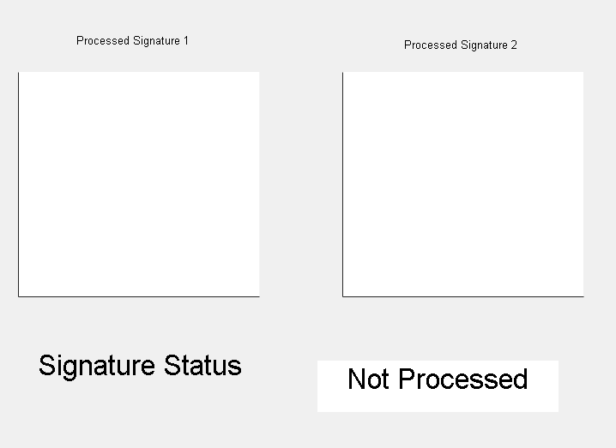
Working
STEP 3:
Both Images are processed and their extracted features are compared to get the output.
BLOCK (1)
BLOCK (2)

Slide 13
Results
We have written a program in MATLAB that identified and distinguishes between genuine and forged signatures with a high accuracy.

Slide 14
References
Research Paper Followed : http://shodhganga.inflibnet.ac.in/bitstream/10603/176862/8/08_chapter%202.pdf

Slide 15
THANK YOU

